Slide 1
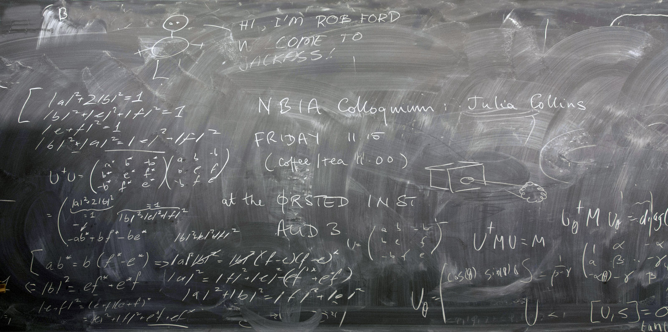
EScribe
Record. Transcribe. Educate.
1003620 Chen Yan
1003769 Wang Tian
1003775 He Yuhang
1003764 Wang Zilin
1003783 Hua Guoqiang
1003510 Leo DIng Hao
1003625 Wong Kai Kang

Slide 2
Outline
Problem Framing
Requirement Analysis
Initial Solution
Project Schedule

Slide 3
Problem Framing

Slide 4
Most classes are
NOT recorded
7%
Classrooms have capture system installed*
Most classrooms do not have a lecture capture system. Even it is installed, only very few classes and instructors use it.
Based on marketing research in China: https://www.chyxx.com/research/201809/678211.html

Slide 5
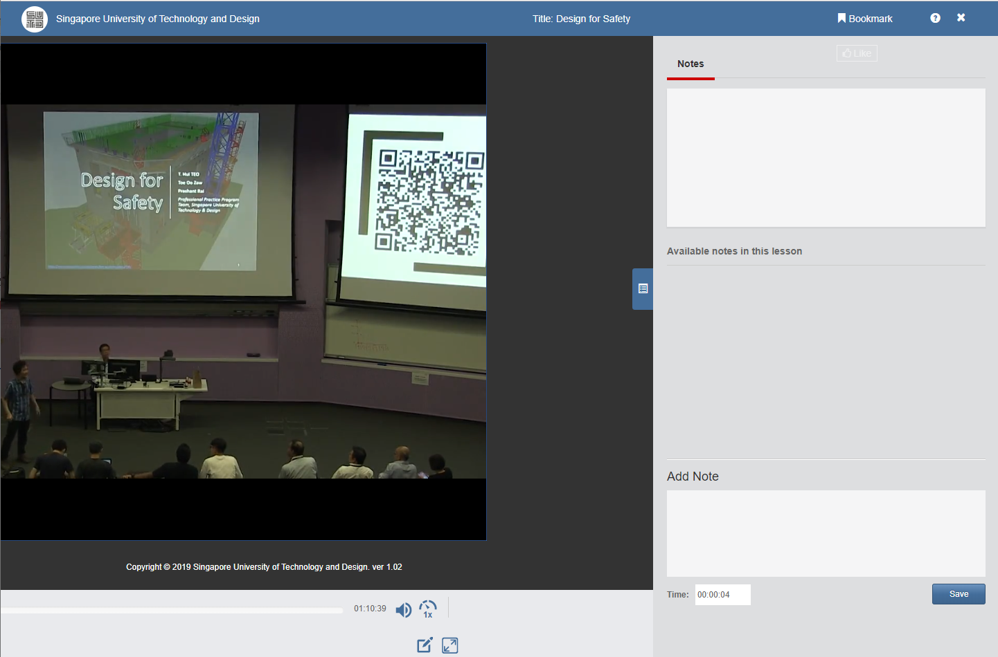

Current Way
No note
Students are limited to their own notes
No search function
student have to sieve through the whole recording to search for a particular point
Notes:
Class recording is not presented in an efficient way

Slide 6

Problem Framing
Problem Definition
Lecture videos are not presented in a way that best assists students’ learning process. To find a certain point covered in class, students might need to sieve through the video and type the point word by word into their notes. This is time-consuming and the students may therefore miss important content.
Context:
Classroom

Slide 7
Requirement Analysis

Slide 8


Requirement Analysis
Stakeholders will want to maximise students’ learning.
During class
As the pace of the classes are fast, it is hard to type down all the key points into their notes.
→ provide a way to help students take notes easier
Stakeholders:
After class
As the video are pretty long, it takes time to find certain topic covered in class.
→ support search function
Students
Universities

Slide 9


Requirement Analysis
Improve the way that class videos are presented such that:
Videos support search function for a particular line of words (handwriting, speech)
Videos enable students to directly copy words that instructor said or written on the whiteboard into their notes.
Key Requirements & Constraints

Slide 10
Initial Solution

Slide 11
Initial Solution
Our main idea is to transcribe every word the instructor said and written on whiteboard into texts using state-of-the-art technologies. By transcribing handwriting and speech into text, we can support search function and make it possible for students to directly copy texts into their notes., and therefore provide students with an interactive, convenient and engaging learning experience.

Slide 12
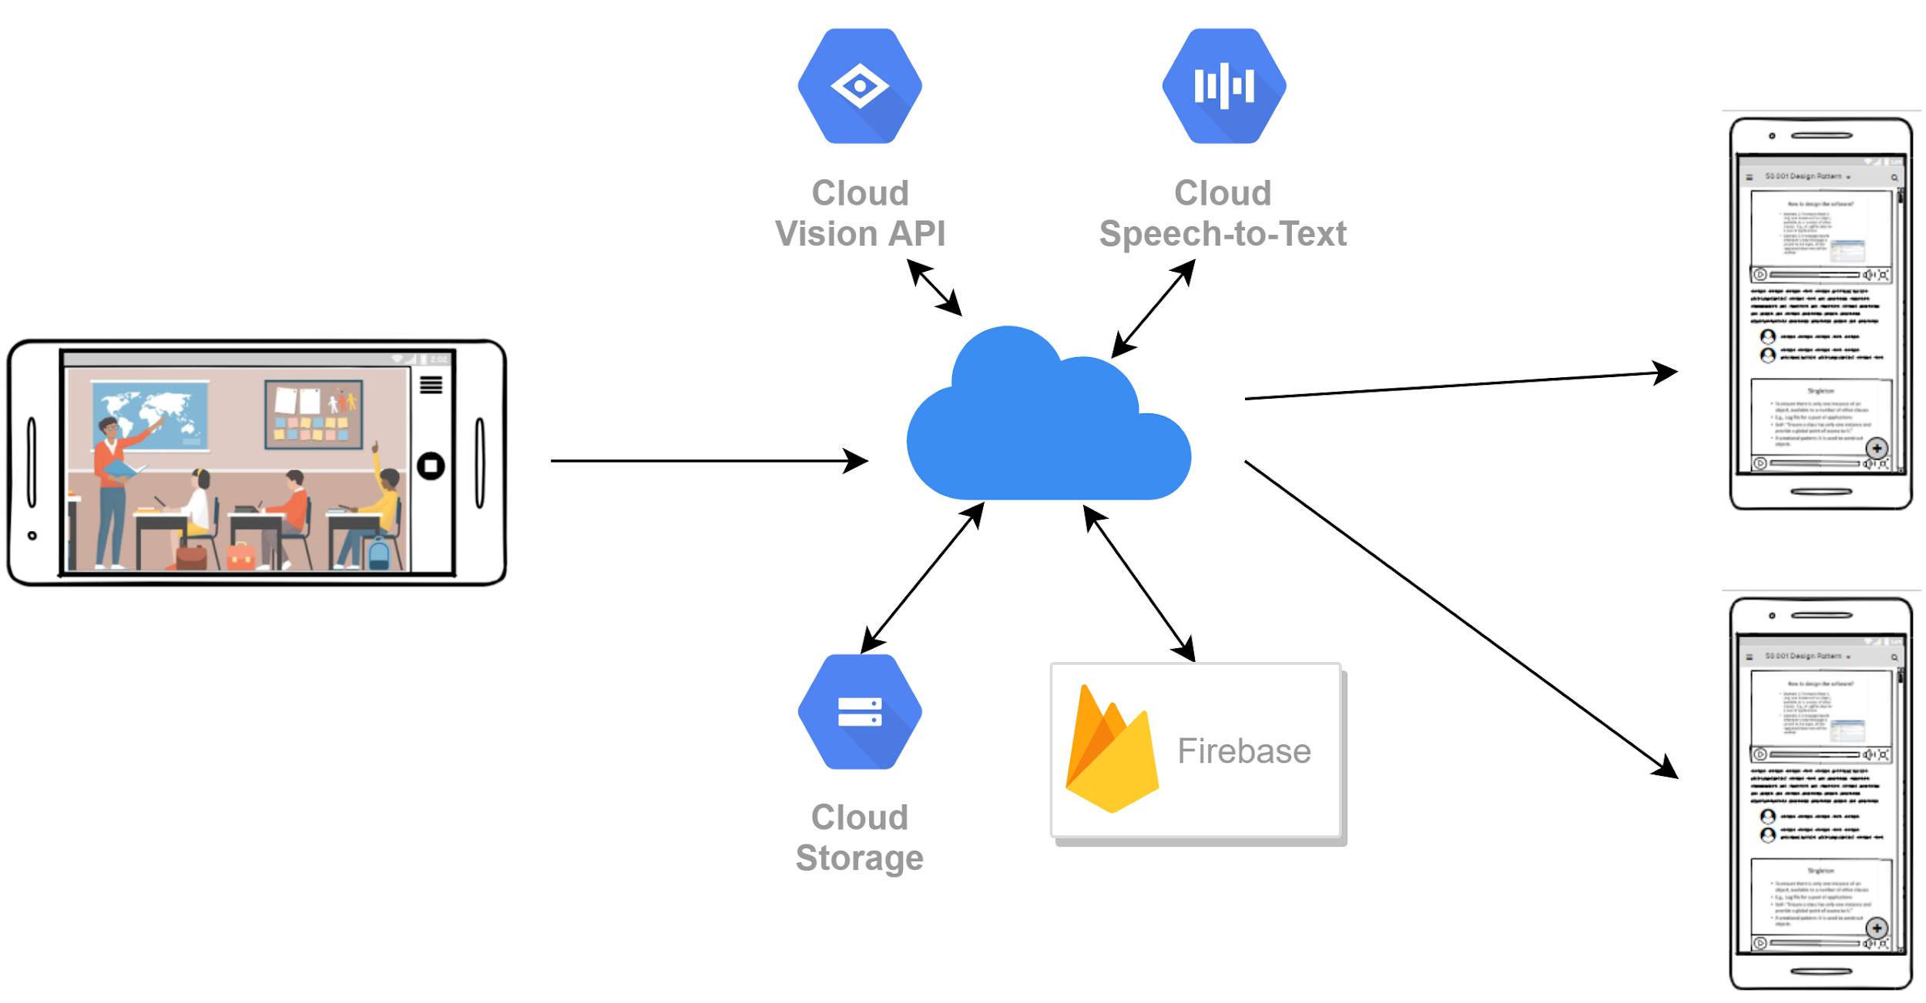
System architecture
Recorder
Server
Viewer

Slide 13
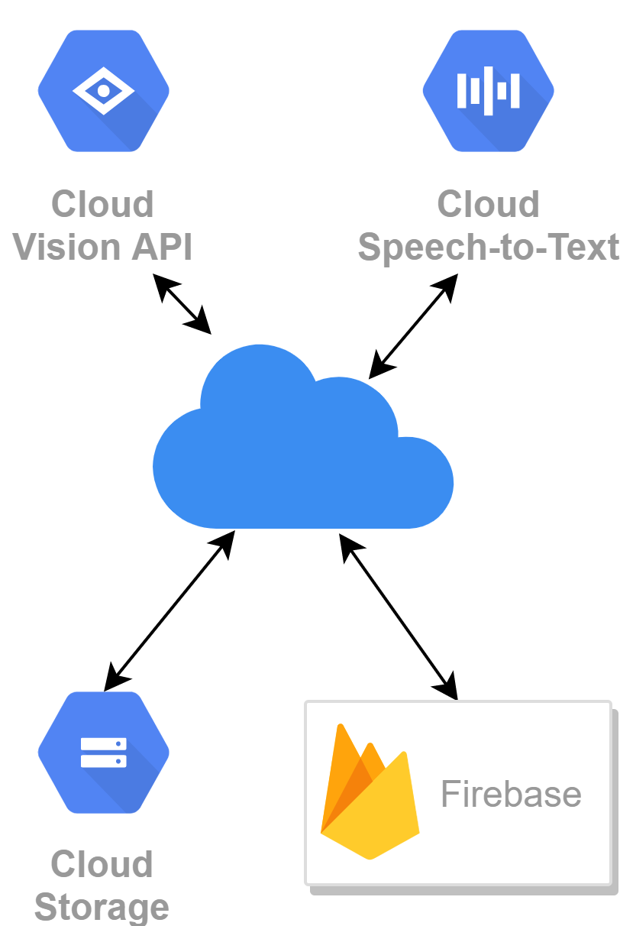

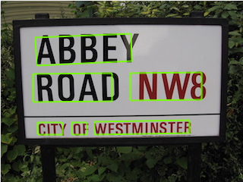
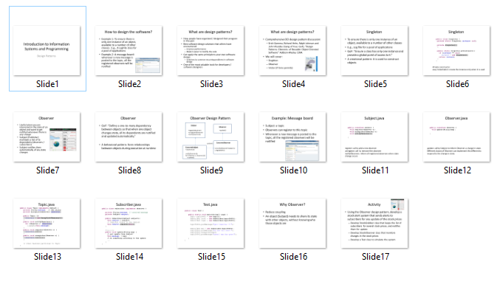
Transcription
ABBEY
ROAD NW8
CITY OF WESTMINSTER
Video url
slide1
texts
W5C1
discussions
50.001
Video url
slide2
texts
...
discussions
...

Slide 14
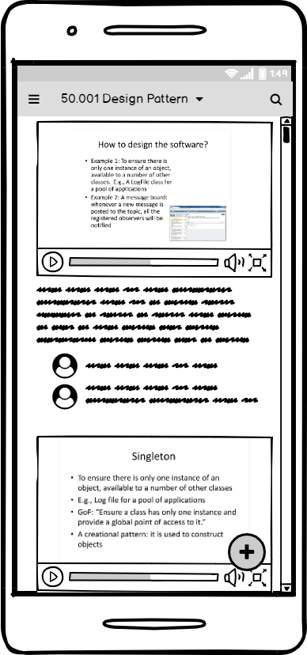
Education
Search
Quickly navigate to certain content
Video slicing
Captured video is attached to individual slide
Content recognition
Recognize text and handwriting on whiteboard and slides, and also instructors’ words
Comments
Post questions, share ideas and discuss
Realtime
Easily copy notes from whiteboard without the need to type.

Slide 15


Comparison
Traditional Lecture Capture System
Our Solution
Replay
Transcription
Search
Discussion
Cost
$XX,XXX
1 Android Phone

Slide 16
Comparison
Traditional Lecture Capture System
Our Solution
Replay
Transcription
Search
Discussion
Cost
$XX,XXX
1 Android Phone

Slide 17
Project Schedule

Slide 18
Project Architecture
EScribe
Server
Viewer App
Recorder App
Video processing
Database
UI
Logic
Leo Ding Hao
He Yuhang
Hua Guoqiang
Wang Zilin
Chen Yan
Wang Kai Kang
Wang Tian

Slide 19
Project Schedule
Week 4
Week 5
Week 6
Week 7
Week 8
Week 9
Week 10
Week 11
Week 12
Research & brainstorm
Prototyping
Poster
Showcase
Presentation
Testing
Recorder App
Hardware
App implementation
Video Process Server
Video slicing
Speech-to-text and OCR
Optimization
Database design
Integration
Viewer App
UI design
Implement search
Implement discussion

Slide 20
Project Schedule
Week 4
Week 5
Week 6
Week 7
Week 8
Week 9
Week 10
Week 11
Week 12
Research & brainstorm
Prototyping
Poster
Showcase
Presentation
Testing
Recorder App
Hardware
App implementation
Video Process Server
Video slicing
Speech-to-text and OCR
Optimization
Database design
Integration
Viewer App
UI design
Implement search
Implement discussion

Slide 21
Questions?

